Slide 1
Species and Organisms

Slide 2
In this lesson we will be doing the following:
1. | Distinguishing the terms organisms and species.
2. | Defining what a hybrid is.

Slide 3
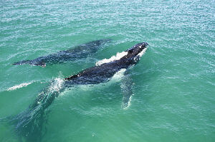

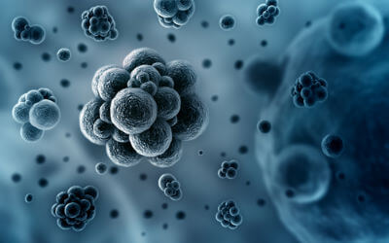
An organism is any living thing.
Plants, animals and bacteria are all organisms!

Slide 4
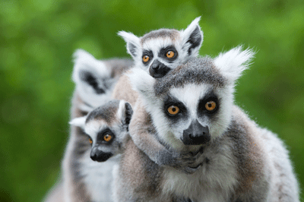
A species is a group of organisms with similar features.
Members of the same species can breed to produce fertile offspring.

Slide 5
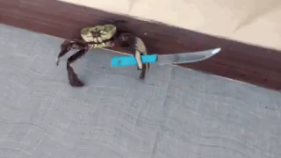
For example:
A male and a female lion are the same species, so they can reproduce and have healthy cubs.
However, a male snake and a female crab cannot reproduce and have babies, because they are different species!

Slide 6
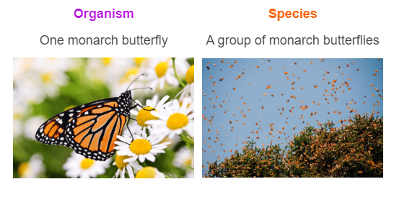
Let's use one more example to highlight the difference between organisms and species.

Slide 7
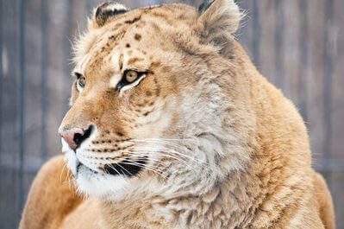
By now, you should have a pretty good idea about why species and organisms are different.
However, there are always exceptions to the rule!

Slide 8
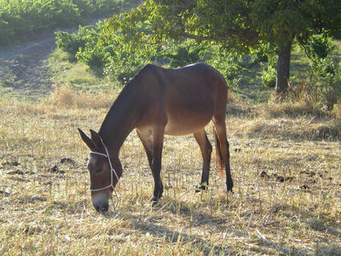
Sometimes, two members of different species interbreed and produce offspring.
These offspring are known as hybrids.
Hybrids are infertile, which means they cannot have offspring of their own.
For example, a mule is a hybrid, produced when a donkey and a horse interbreed. Donkeys and horses are closely related, but are different species!

